Slide 1

Pac-Man Quicksilver Ver
Bill Huang, Yang Zhou, Zhen Gao,
Jeff Zhou, Jianing Lou, Jerry Zhang, Zhengtong Liu

Slide 2

Agenda
App design
Design patterns
UI demo
Q & A

Slide 3

App Design

Slide 4
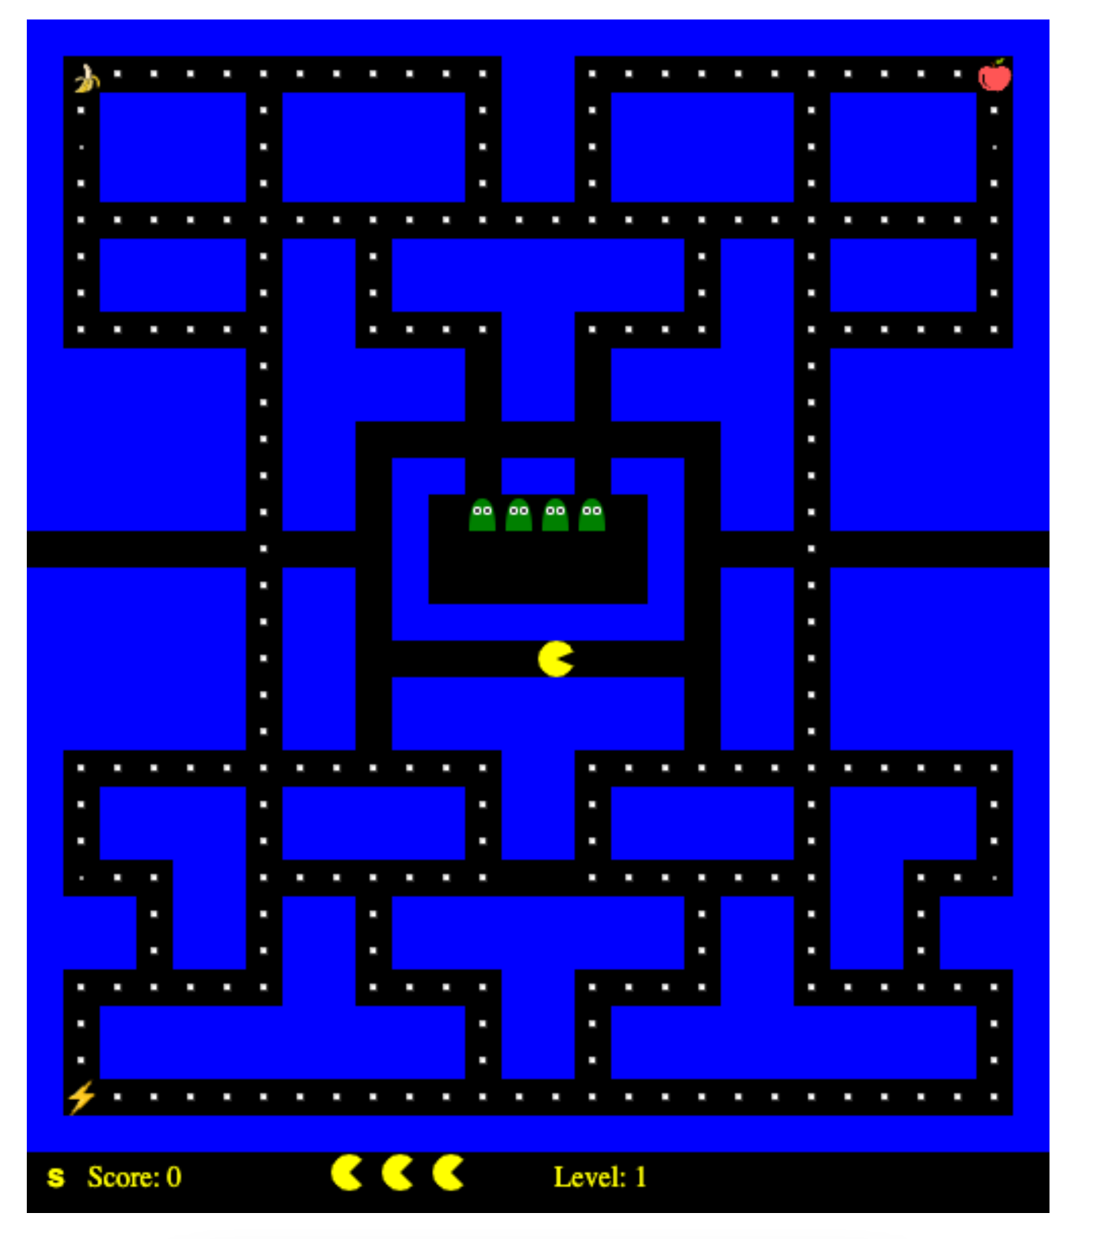



Design features
Superpower of Quicksilver
Update by tick
No respawn, even if you lose a life
Extensibility

Slide 5

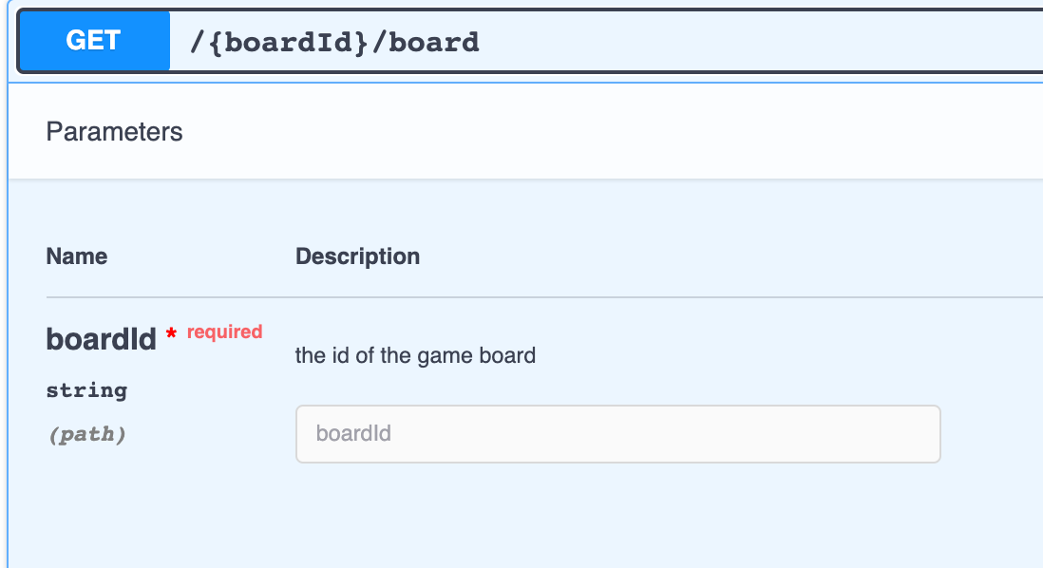
Endpoints
GET {boardId}/board
Gets the board data
Board data passed in 2D array
Front End render the 2D array into game board.

Slide 6
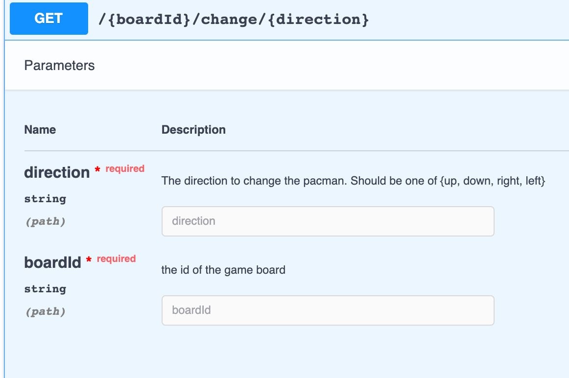
Endpoints
GET {boardId}/change/direction
Respond to user input(keyDown)
Change the direction of the pacman

Slide 7
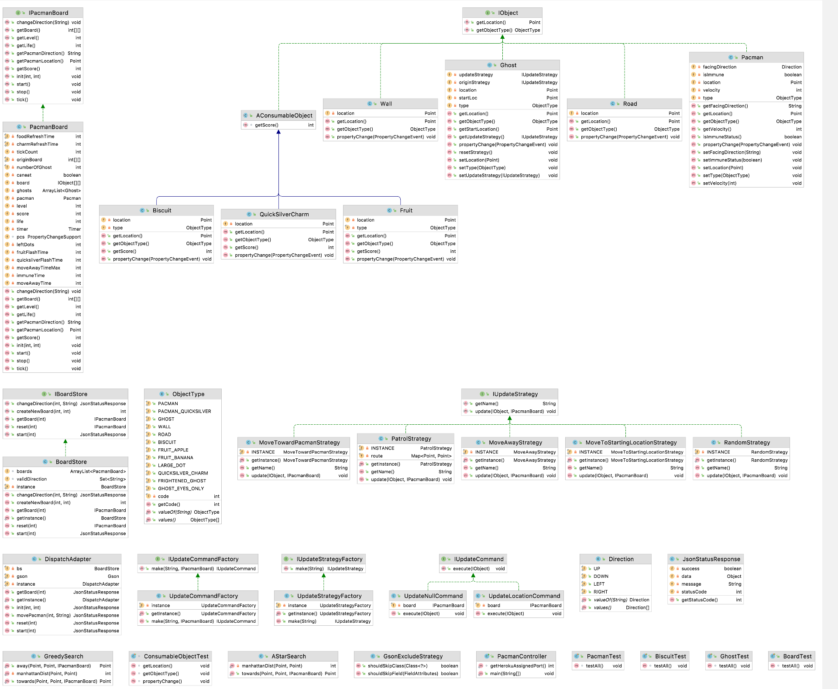
UML Diagram

Slide 8
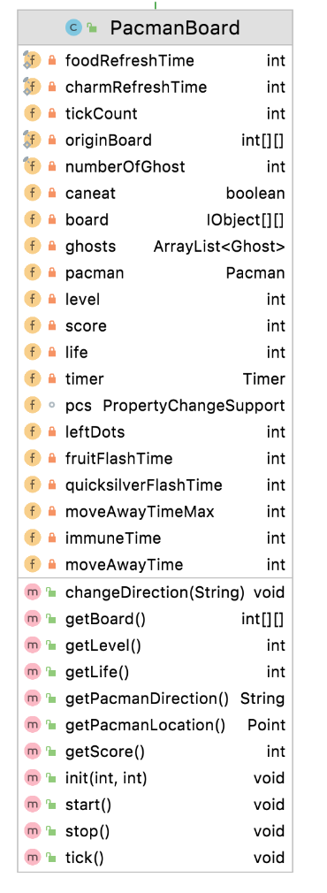
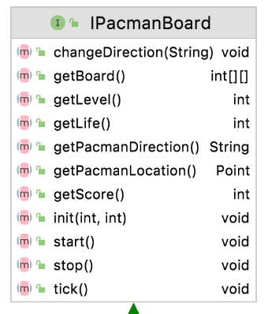
Board
Stores all the elements in one game
Responsible for maintaining the states for the elements
Responsible for maintaing the game logic inside tick()
In tick, every movable objects moves towards specified direction and then do collision detection, etc.

Slide 9
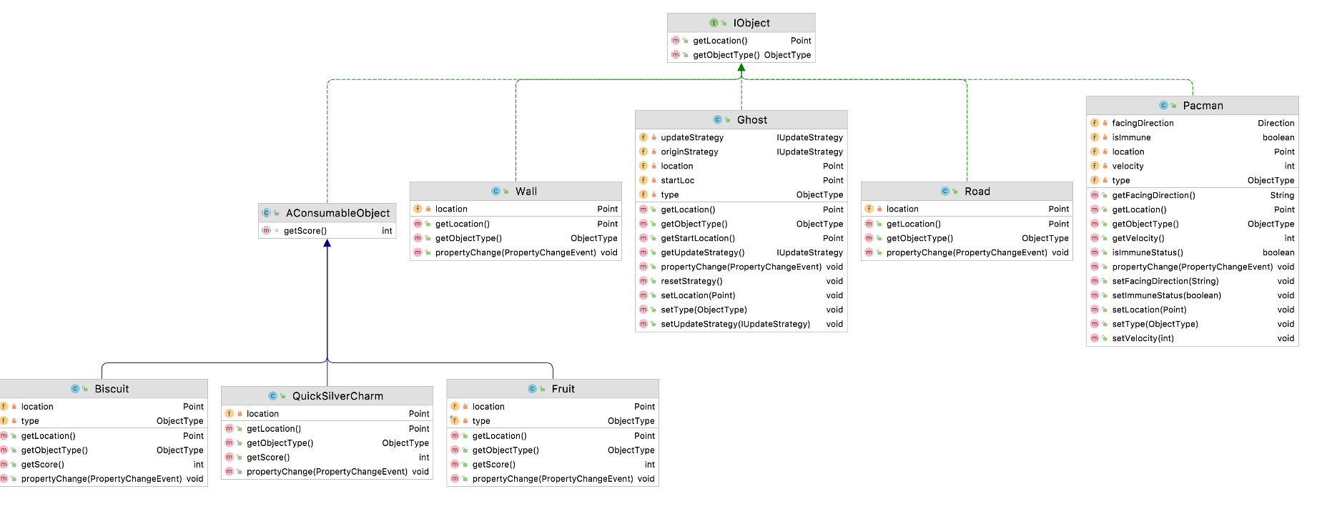
Objects
IObject
AConsumableObject
Biscuit
QuickSilverCharm
Fruit
Wall
Ghost
Road
Pacman

Slide 10
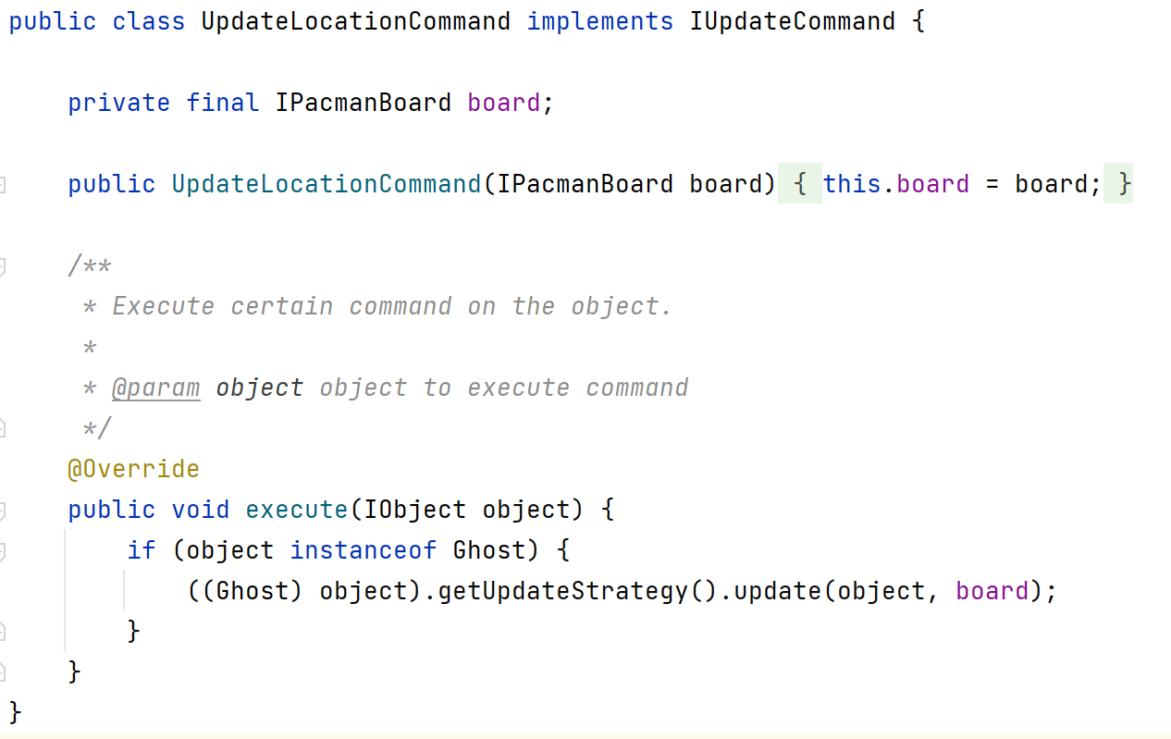
Commands
interface IUpdateCommand
Class UpdateLocationCommand
Class UpdateNullCommand
Interface IUpdateCommandFactory
Class UpdateCommandFactory

Slide 11
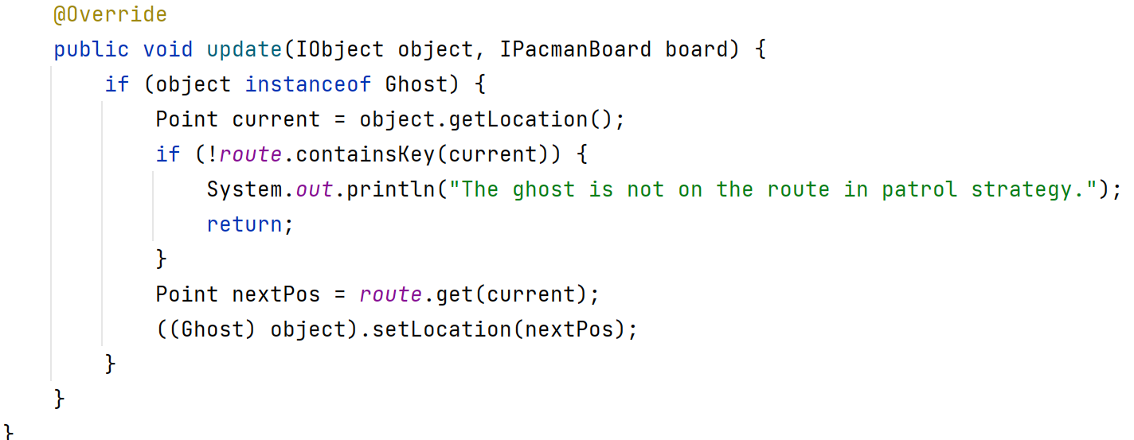
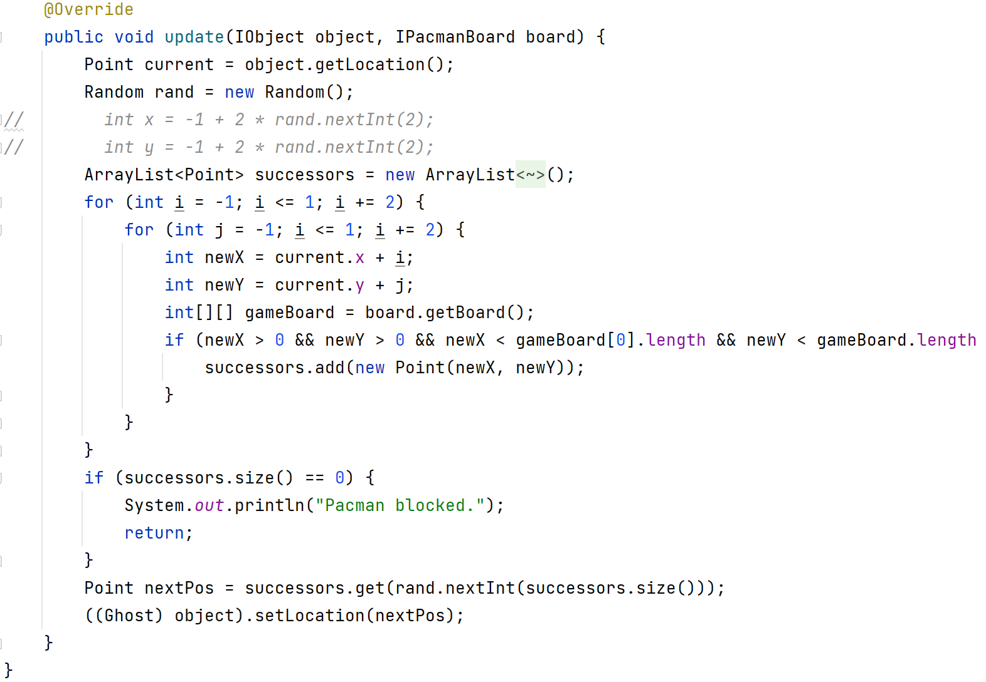
Strategies
interface IUpdateStrategy
Class MoveAwayStrategy
Class MoveToStartingLocationStrategy
Class MoveTowardPacmanStrategy
Class PatrolStrategy
Class RandomStrategy
interface IUpdateStrategyFactory
class AStarSearch
class GreedySearch
class UpdateStrategyFactory

Slide 12





Design Patterns
1. Strategy Design Pattern
2.Command Design Pattern
3. Observer Design Pattern
4. Factory Design Pattern
5. Singleton Design Pattern

Slide 13
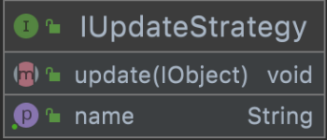
Strategy Design Pattern

Slide 14
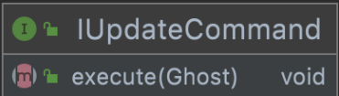
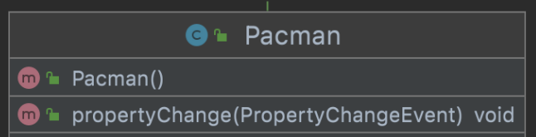
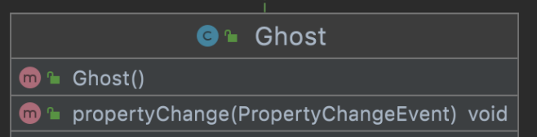
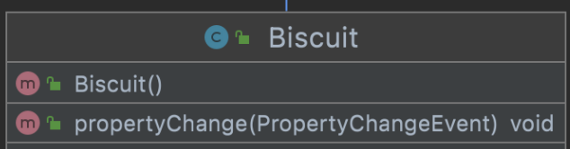
Command Design Pattern
Observer Design Pattern

Slide 15
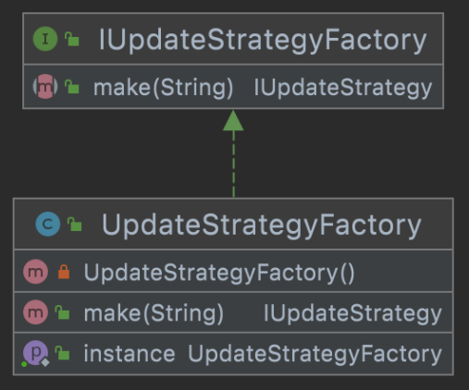
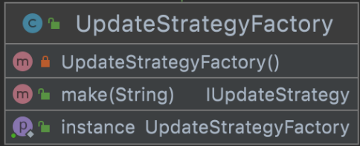
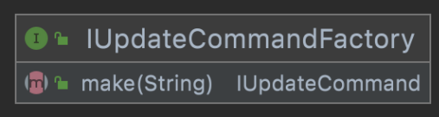
Factory Design Pattern
Singleton Design Pattern

Slide 16
Demo

Slide 17
Q&A

Slide 18
Thanks for listening！

